Slide 1
Graph
CSE 2213 – Discrete Mathematics

Slide 2
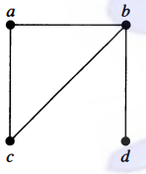

Graph
A graph $G=(V,E)$ consists of $V$, a nonempty set of vertices (or nodes), and $E$, a set of edges.

Slide 3
Different types of graph
Undirected Graph
Simple graph
Multi graph
Pseudo graph
Directed Graph
Simple directed graph
Directed multigraph

Slide 4
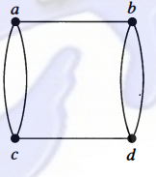

Undirected Graph
Each edge connects two different vertices
Represented by an unordered pair of two vertices
An edge that connects $u$ and $v$ is written as $\{u,v\}$

Slide 5
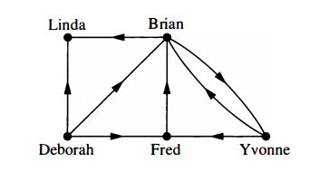
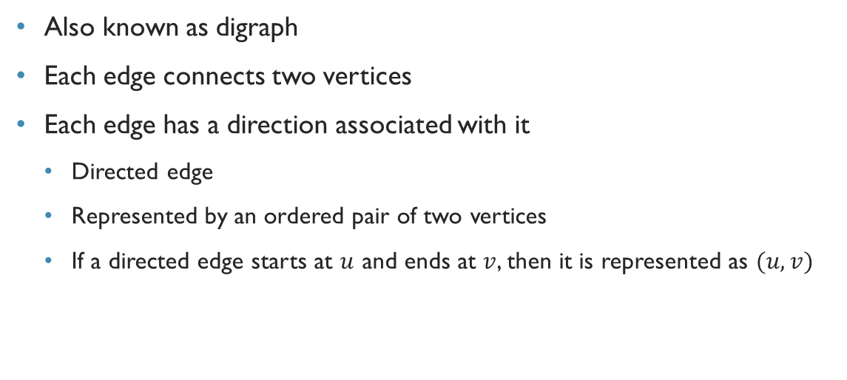
Directed graph
Also known as digraph
Each edge connects two vertices
Each edge has a direction associated with it
Directed edge
Represented by an ordered pair of two vertices
If a directed edge starts at $u$ and ends at $v$, then it is represented as $(u,v)$

Slide 6
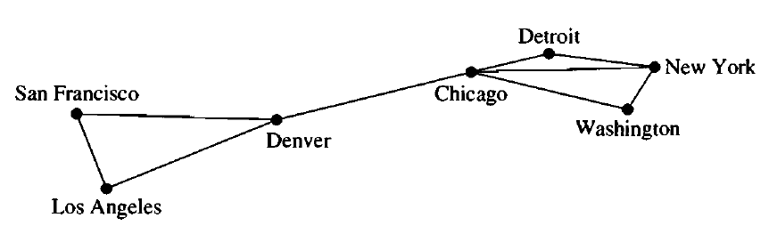
A computer network
The data centers of a company are geographically distributed
This graph shows the connection between data centers
What sort of graph is it?

Slide 7

Simple graph
Each edge connects two different vertices
Represented by an unordered pair of two vertices
An edge that connects $u$ and $v$ is written as $\{u,v\}$
No two edges have the same pair of vertices

Slide 8
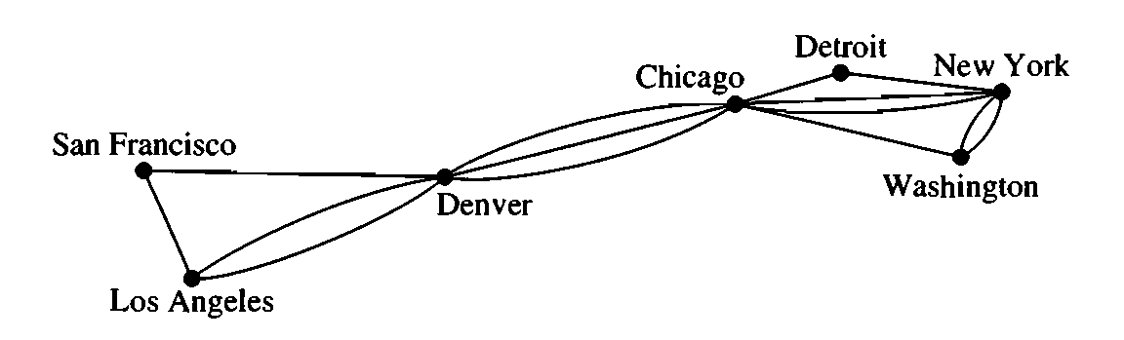
A computer network
This graph shows links between data centers
Note that there exists multiple links between some pair
What sort of graph is it?

Slide 9
Multigraph
Graphs that may have multiple edges connecting the same vertices are called multigraphs.

Slide 10
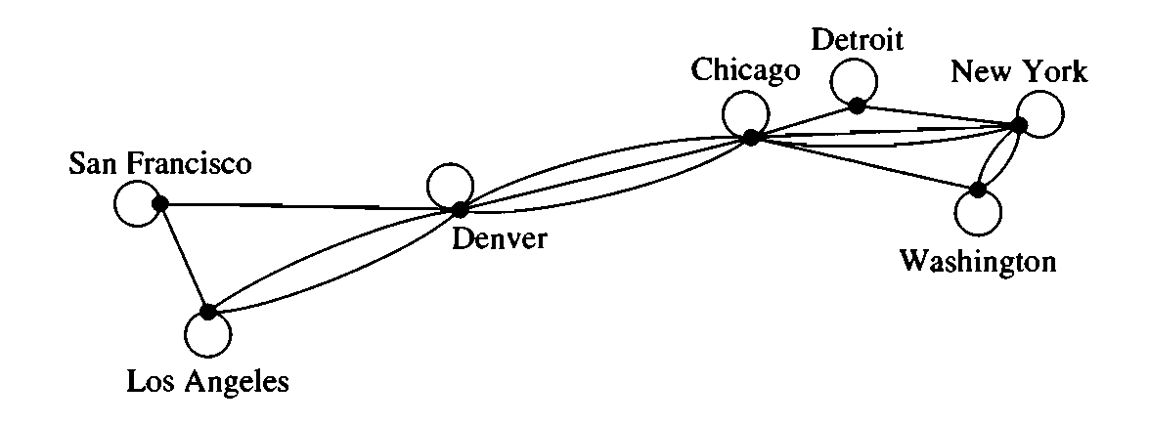
A computer network
Now there are links that connect a data center to itself!!!
What sort of graph is it?

Slide 11
Pseudograph
Each edge connects two vertices
There may exist edges that connect the same pair of vertices
There may exist edges that connect a vertex to itself
Known as loops

Slide 12
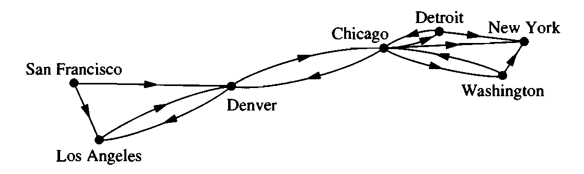
A computer network
This time the links are simple and data can be passed in one direction through a link
What sort of graph is it?

Slide 13
Variants of directed graph
Simple directed graph
No multiple edge, no loop
Directed multigraph
Multiple edge allowed, loop allowed

Slide 14
Mixed graph
Edges may be directed, or undirected
Multiple edges allowed
Loops allowed

Slide 15
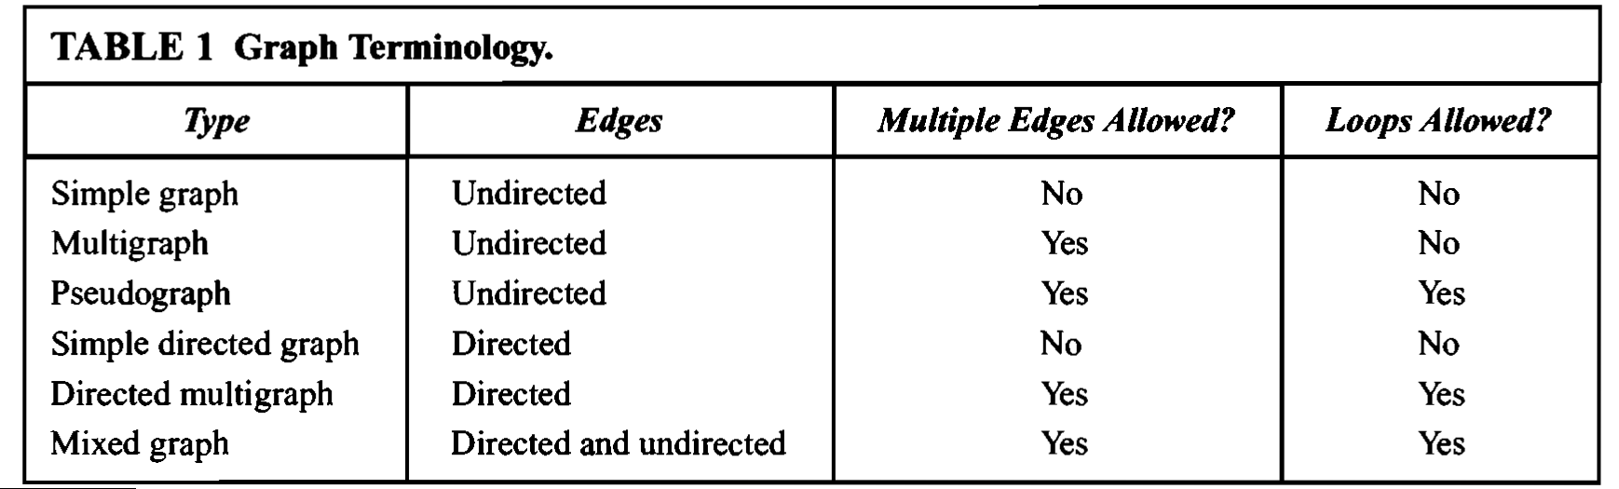
Different types of graphs

Slide 16
Exercise
Chapter- 9.1 (Rosen,6th edition)
Page-596
Ex: 4,5,7,8,9

Slide 17
Exercise
Acquaintanceship graph
A graph that represents whether two people knows each other or not
What sort of graph is it?

Slide 18
Exercise
Hollywood graph
A graph that represents whether two actors have worked together in movies
What sort of graph is it?

